Slide 1
Executive Summary UMC Board of Trustees Presentation
DRAFT February 2, 2011
Notes:
1

Slide 2
Session Objectives and Schedule Overview
Summary Findings, Opportunities and Recommendations
Communicate/Disseminate Executive Summary
Meetings / Next Steps:
Executive Communication – Steering Committee 2/1/2011 and UMC Board of Trustees 2/2/2011
Presentation to UMC Advisory Board 2/9/2011
Planning regarding implementation / deployment
2

Slide 3
Summary Finding, Opportunities and Recommendations
3

Slide 4
Summary Findings and Recommendations
Reimbursement is Decreasing and Expenses are Unsustainable:
The State Budget deficit is projected to be $3 billion over the next two years. In addition, reimbursement reductions of 5-10% have been proposed. This represents a reduction $3-5M reduction.
The major conclusions from the trend analysis for UMC and Clark County are:
If uninterrupted, negative trends in volume, net revenue, and unsustainable expenses will lead to increased annual operating deficits of over $10 million per year to an operating deficit in excess of $100 M by FY2014.
Limited funding of $65 M is available from Clark County to support the operating deficit and capital requirements of UMC.
Without significant changes in governance structure, immediate process improvements and cost reductions, UMC will be forced to significantly reduce clinical scope or close within 3 years.
4

Slide 5
Summary Findings and Recommendations
UMC must improve revenue and reduce cost immediately to be able to sustain operations for even the short-term. FTI firmly believes a sustainable improvement of $44 M is achievable by FY2014.
Competition from several major health systems and private ventures has continued to draw volume away from UMC facilities. Health Reform promises to intensify UMC’s competitive environment by allowing newly insured individuals a choice of health care facilities or systems.
If pursued, academic medicine at UMC will be (for the foreseeable future) a hybrid culture with community and university physicians working together. It is important for UMC and UNSOM leadership to espouse this realistic and non-threatening view.
Since there is no significant “new” money for programmatic initiatives/recruitments (aside from possible future philanthropy), reallocation of current resources will be critical.

Slide 6
Summary Findings and Recommendations
Given the UMC situation, we recommend the County consider most carefully the 501c3 "public benefit corporation" model.
In this model, the County government transfers direct management of the public hospital to an independent, self-perpetuating Board. But the County also retains specific powers to ensure the public service mission is met. These may include, for example, the powers to:
Approve an annual "health service plan“
Approve appointment of the Health System CEO
Require certain services via a funding agreement based on what finances the government can support
Require quarterly or annual reports on the level of services, costs, quality and patient satisfaction

Slide 7
University Medical Center – Financial Performance
7

Slide 8
FTI Assessment Findings

Slide 9
FTI Assessment Summary Risks and Other Factors
UMC operates in a very challenging environment which is impacted by several national, state and local issues. UMC is at risk for several new issues which could further impact the baseline projection and increase the deficits.
The State Budget deficit is projected at $3 billion over the next two years and proposed rate reductions of between 5-10% have been proposed (impact to UMC revenue reduction of approximately $ 3-5 million per year).
Competition from several major health systems and private ventures have continued to draw volume away from UMC facilities.
County support for UMC is partially driven by property tax revenue for indigent care which is expected to undergo reductions due to local economic factors and housing valuations.
Future PERS funding is expected to increase to cover past low investment returns which will continue to put pressure on local governmental entities.
Future Retiree Healthcare Funding requirements will increase cash requirements from the County (could have increases of $1 million per year on a compounded basis).
Based on the projection and the above issues, UMC and the County need to develop and implement plans to improve operations and cost structure by nearly $50 million per year ($35 million core projection plus $5-15 million in future risk elements).

Slide 10
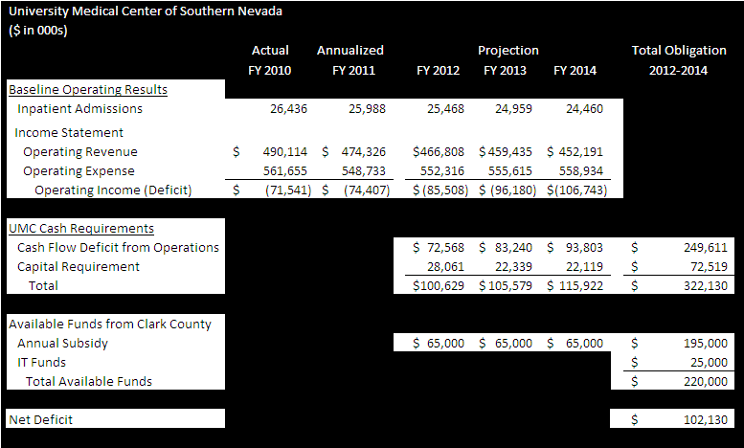
Financial Performance Summary
Based on historical trends, the financial projection for UMC reflects the following:
Trends in volume, net revenue, and expenses are expected to result in increasing operating deficits (climbing at over $10 million per year) to nearly $100 million within the next three years.
UMC has several significant cash flow requirements including the operating loss and capital investments which are required to be funded to sustain current operations.
Clark County has a limited capacity to support UMC ($65 million per year for operations and $25 million in capital funds).
UMC and Clark County need to immediately address the areas of potential operational improvement to reduce the impending $100 million cumulative cash flow deficit projected over the next three years.

Slide 11
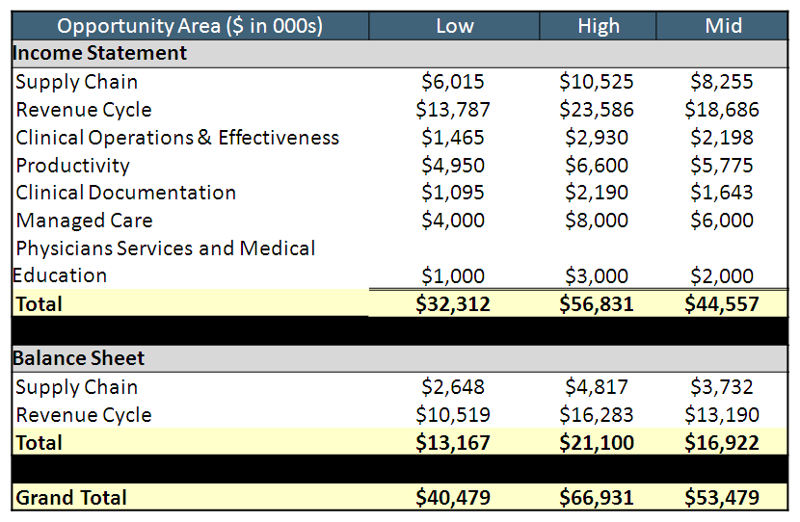
FTI Assessment Summary Opportunity Assessment
FTI completed a review of the UMC facilities, clinical operations, revenue cycle and expenses. The income statement opportunities represent nearly an 8% improvement in operating results at the mid-point and demonstrates a significant organization-wide effort.

Slide 12
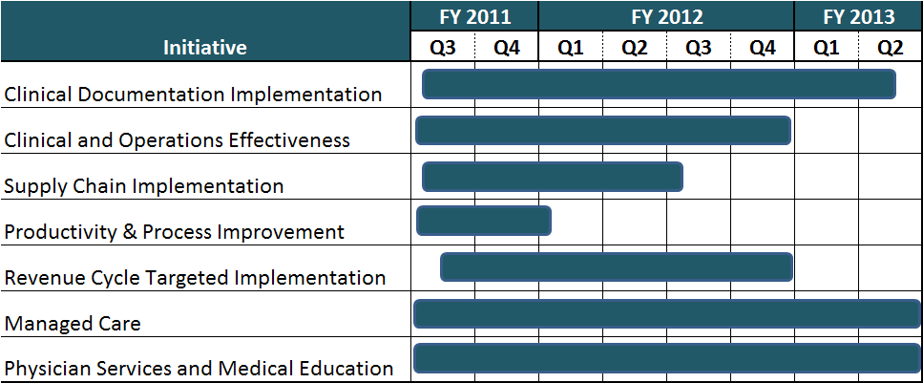
Overall Opportunity Management Action Plan – by Discipline
To realize the identified benefit, implementation activity would require focused initiatives lasting (in duration) anywhere from 6 to 24 months.

Slide 13
Financial Conclusions
1) UMC must undertake immediate steps to improve revenue and reduce cost to be able to sustain operations for even the short-term (2-3 years).
FTI believes an improvement of nearly $70 M is achievable through FY 2013 ($2 million in FY 11, $32 million in FY 12, $39 million in FY 13).
This can only be accomplished through a focused plan, established goals and objectives.
A strong management-driven approach and commitment to a timeframe is essential.
Responsible parties must be identified to take full responsibility for achieving these outcomes.
There is a need to supplement current UMC leadership with a full time Chief Implementation Officer to drive this process.
2) UMC and Clark County need to evaluate other potential governance and operational improvement opportunities (e.g. employment compensation and benefit restructuring) to ensure that the future of the Hospital and medical services are available in the community.

Slide 14
UNSOM / UMC

Slide 15
UNSOM / UMC Scope & Approach
Evaluate current relationship between UMC and UNSOM/NSHE.
Evaluate the current mission of UMC as a teaching hospital and how that mission impacts the operations and structure of the organization.
Comment on the current and proposed relationships between the clinical and academic elements, including an exploration of enhanced research opportunities.
Outline recommendations for the creation of an Academic Health Center (AHC).

Slide 16
UNSOM / UMC Key Findings – Advantages/Disadvantages for UMC
Transition of UMC to an Academic Health Center (AHC) model through closer collaboration with UNSOM and other NSHE institutions poses certain advantages and disadvantages.
Potential Advantages for UMC:
Development of a medical staff devoted to the clinical and financial goals of UMC
Achieve a higher level of clinical expertise in areas in which the hospital must excel
Development of Centers of Excellence which will allow UMC to differentiate its brand in the Las Vegas market
Enhance reputation for training the future healthcare professional workforce of the region
Potential Risks for UMC:
Loss of allegiance of key community physicians
Concerns about past experience with UNSOM faculty
Reputations of UMC and UNSOM have challenges
UNSOM faculty does not have sufficient numbers and depth of clinical faculty, especially in terms of the range of specialty services available
Perception that UMC is affiliating with a Reno-based organization (North-South issues)
Financial burden

Slide 17
UNSOM / UMC Key Findings – Advantages/Disadvantages for UNSOM
Transition of UMC to an Academic Health Center (AHC) model through closer collaboration with UNSOM and other NSHE institutions poses certain advantages and disadvantages
Potential Advantages for UNSOM:
Provides the potential for UNSOM to move from a community medical school to a more comprehensive model
Greater control of clinical environment; this impacts all missions of UNSOM and will facilitate recruitment of clinical faculty
If UNSOM is positioned favorably with regard to clinical contracts and services at UMC, there should be a positive economic impact on the practice plan
Potential Risks for UNSOM:
Dispersion of scarce resources (money, people) over two geographically distant sites
Separation of the home base for basic sciences (Reno) from the center of gravity for clinical activities (Las Vegas)
Tying UNSOM to a safety net hospital whose reputation and financial viability are suboptimal
Financial burden

Slide 18
UNSOM / UMC Key Recommendations – UNSOM Expansion of Faculty
An expanded UNSOM faculty must be aligned with and accountable to UMC in order to take a larger role in the hospital’s activities.
Expansion of UNSOM faculty through:
Recruitment of outstanding clinicians (who participate in and/or respect the academic mission). These individuals must have “added value” skills; i.e. they need to bring desirable skills to the organization.
Recruitment of community physicians who embrace the academic health center concept and can positively contribute to the clinical mission of UMC.
Recruitment packages should be jointly funded by UMC and UNSOM.
Such faculty must comprise a core group that will
Develop Centers of Excellence
Enhance the consistency and quality of care
Link inpatient and outpatient care
Although formation of an AHC is not a short-term answer to UMC financial concerns, in the long-term, an expanded UNSOM faculty aligned with UMC is the key to changing the payer mix, thereby providing a foundation for ongoing fiscal sustainability.

Slide 19
UNSOM / UMC Key Findings – Community Physicians, UNSOM Faculty and UMC
Relationships between community and UNSOM physicians: Implications for UMC
Successful interactions between community physicians, UNSOM faculty and UMC are critical in order to:
Maintain a functional hospital, especially at the present time.
Expand the clinical faculty by recruitment of select community physicians
Continue (and increase) admissions by community physicians who are affiliated with UMC and UNSOM.
Academic medicine at UMC will be (for the foreseeable future) a hybrid culture with community and university physicians working together. It is important for UMC and UNSOM leadership to espouse this realistic and non-threatening view.
As UNSOM represents about 10% of the medical staff at UMC, the hybrid model is the only feasible path forward.
Since there is no significant “new” money for programmatic initiatives/recruitments (aside
from possible future philanthropy), reallocation of current resources will be critical.

Slide 20
UMC of Southern Nevada
Governance and Structure

Slide 21
Governance
Without major, dramatic and profound change in structure and immediate process improvements and cost reductions, UMC will be forced to close within a few years.
There is general belief that the State, County or community will not step in and interrupt the trajectory toward closure.
3. UMC and UNSOM are not aligned and do not work to mutual benefit. A mutually-reinforcing governance and organizational structures are required.

Slide 22
Governance
4. Creating an academic health center (AHC) is likely part of the long-term solution, but will not solve the existing financial problems in the near future and is likely to add cost.
5. We have considered a range of ownership and governance and recommend that UMC become an independent 501(c)(3) “Safety Net” Hospital Corporation. In this model, the County government transfers direct management of the public hospital to an independent, self-perpetuating Board. But the County also retains specific powers to ensure the public service mission is met. These may include, for example, the powers to:
Approve an annual "health service plan“
Approve appointment of the Health System CEO
Require certain services via a funding agreement based on what finances the government can support
Require quarterly or annual reports on the level of services, costs, quality and patient satisfaction

Slide 23
Governance
6. Assuming costs are reduced, enhanced processes are put in place and a favorable governance model is adopted, UMC in any future state must have significant philanthropic support from the Las Vegas community.
7. Community financial support is not possible without significantly distancing the County from governance and management of the existing organization or any new structure. In addition, collaboration with and support from Labor are imperative to achieve a financially sustainable model.
Two concurrent components of restructuring are required:
Improving financial performance in the operation of UMC, while
Establishing the governance and operational prerequisites, e.g. a 501©(3), for an AHC that, supported by the community, can compete and succeed in the long run.

Slide 24
Discussion and Action Items

