Slide 1
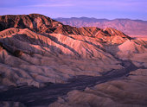
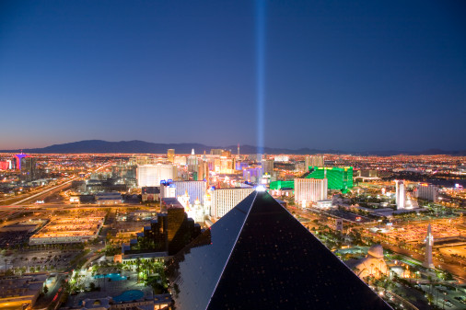
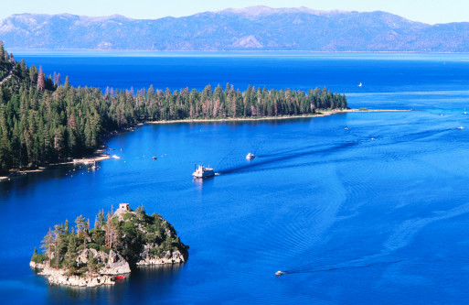
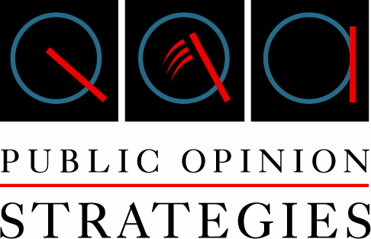
NEVADA
STATEWIDE SURVEY
Key findings from a statewide survey of
500 likely voters in Nevada,
conducted February 15-16, 2010
Glen Bolger
glen@pos.org
Project #10093

Slide 2
Methodology
Public Opinion Strategies is pleased to present the key findings of a statewide telephone survey conducted in Nevada. The survey was completed February 15-16, 2010 among 500 likely voters and has a margin of error of +4.38%.
Glen Bolger was the principal researcher on this project. Jim Hobart was the project director, and Bryan Kitz provided analytical support.

Slide 3
Political
Environment

Slide 4
Nevada voters are even more pessimistic about the direction of the state than they were in May.
“And, would you say that things in Nevada are going in the right direction, or have they pretty seriously gotten off on the wrong track?”
May 2009
February 2010

Slide 5
The GOP leads the generic ballot among all gender/age groups except younger women, but many are undecided.
“And, if the election for state legislature in your district were being held today, for whom would you vote...the Republican candidate....OR....the Democratic candidate ...for state legislature from this district?”
Overall
By Gender/Age + Seniors
+19%
+19%
-9%
+2%
+2%

Slide 6
Name ID
& Images

Slide 7
Both Jim Gibbons’ and Rory Reid’s images are upside down. Brian Sandoval’s image is solid.
Governor Candidates Name ID/Image Ranked by % Favorable

Slide 8
The early ads did not help. Senator Reid’s image is terrible.
US Senate Candidates Name ID/Image Ranked by % Favorable

Slide 9
Re-Elect &
Ballot Tests

Slide 10
Anti-incumbent sentiment is strong across party lines.
“And, do you think your state legislator has performed their job well enough to deserve reelection,
or do you think it's time to give a new person a chance to do a better job?”
Overall
By Party
Total Re-Elect: 14%
Total New Person: 71%
-72%
-70%
-75%
-56%
-29%

Slide 11
Lowden and Tarkanian lead the GOP primary ballot, but many voters are undecided.
“If the Republican primary election for U.S. Senate were being held today, for whom would you
vote if the candidates were...”

Slide 12
Sandoval leads incumbent Governor Jim Gibbons on the primary ballot.
“If the Republican primary election for Governor were being held today, for whom would you
vote if the candidates were...”
Total Gibbons: 32%
Total Sandoval: 38%
Total Montandon: 9%

Slide 13
Reid fails to top 40% against any potential opponent.
“And, if the election for U.S. Senate were being held today, for whom would you vote if the candidates were...”

Slide 14
Tea Party Candidate Vote – Low and High
 | Teas Party Candidate vs. Lowden | Tea Party Candidate vs. Chachas
Base GOP (26%) | 11% | 28%
Soft GOP (11%) | 16% | 36%
Ind (18%) | 19% | 34%
Soft Dem (16%) | 4% | 12%
Base Dem (26%) | 2% | 6%
Clark (66%) | 11% | 23%
Washoe (20%) | 8% | 20%
Rural (14%) | 7% | 19%
White (77%) | 10% | 23%
Total Minority (19%) | 5% | 14%
Af Am (8%) | 3% | 6%
Hispanic (8%) | 6% | 13%

Slide 15
Tea Party Candidate Vote – Low and High cont.
 | Teas Party Candidate vs. Lowden | Tea Party Candidate vs. Chachas
Men 18-49 (21%) | 14% | 31%
Men 50+ (26%) | 11% | 25%
Women 18-49 (27%) | 7% | 18%
Women 50+ (24%) | 6% | 16%
65+ (21%) | 5% | 16%
Very Cons (22%) | 17% | 33%
Smwt Cons (19%) | 9% | 27%
Mod (36%) | 10% | 19%
Total Lib (21%) | 2% | 11%
Mod/Lib GOP (9%) | 5% | 22%
Cons Dem/Ind (12%) | 10% | 25%

Slide 16
Jim Gibbons is the weakest GOP candidate against Reid.
“Thinking now about the race for Governor…And, if the election for Governor were being held today, for whom would you vote if the candidates were...”

Slide 17
Issues

Slide 18
Jobs and the economy are by far the most important issues to voters.
Top Issues Ranked by % First Choice (2/10)
Jobs and The Economy
Education
State Spending
Illegal Immigration
Housing/Foreclosures
Health Care
Taxes
Nuclear Waste/Yucca Mt.
Moral Values
Gas/Energy Prices
Transportation/Roads
The Environment

Slide 19
Nevada voters remain pessimistic about the state of the economy.
“Now I would like to talk to you about the state of the economy...Nevada has recently been going through a difficult time. Do you feel that the worst is over or is the worst is still to come?”
May 2009
February 2010

Slide 20
Fewer Nevadans think that unemployment will continue to rise in the state.
“And, as you may know Nevada’s unemployment rate is the highest it has been in decades. Over
the next year, do you think Nevada’s unemployment will...”
May 2009
February 2010

Slide 21
The number of voters who have personally lost jobs, lost homes, or taken pay cuts has increased since May.
“Many people in Nevada have lost their jobs, lost their homes, or been forced to take pay cuts
during this economic downturn. Have you or someone you know suffered from one of these?”
May 2009
Total Self: 25%
Total Someone Else: 54%
Total No: 29%
February 2010
Total Self: 31%
Total Someone Else: 56%
Total No: 24%

Slide 22
Voters think the state budget shortfall is very serious.
“As you may know, Nevada currently has a state budget shortfall...would you say the state budget shortfall is”
May 2009
February 2010
Total Serious: 95%*
Total Not Serious: 4%
Total Serious: 97%
Total Not Serious: 1%

Slide 23
Though down since May, a majority of Nevadans still consider the state’s current level of taxation about right.
“Thinking about the state taxes you pay, do you consider the overall amount of state taxes you pay to be...”
May 2009
February 2010

Slide 24
Voter opinions about how to address the budget shortfall have not changed since May.
“And, thinking some more about the budget shortfall, would you rather the Governor and State Legislature CUT SPENDING for state employee salaries and government services such as education and health care, or RAISE YOUR TAXES to avoid these cuts?”
May 2009
February 2010

Slide 25
Nevada voters increasingly feel that everyone should bear the burden of increased taxes.
“And, if the Governor and State Legislature were to raise taxes, who do you think should be paying increased taxes?”

Slide 26
A large majority believe that any tax increase undertaken to address the budget shortfall should be temporary.
“And, if taxes are increased as part of a plan to end the budget shortfall, do you think any tax increases should be temporary until the state’s economy and budget improve, or do you think those tax increases should be permanent?”
May 2009
February 2010

Slide 27
Most Nevada voters think fee increases are the same as tax increases.
“Some members of the Legislature say that tax increases will harm our economy but, at the same time, they are calling for an increase in fees to cover some of the budget shortfall. Do you believe that fee increases are essentially the same as tax increases?”

Slide 28
A majority of Nevada voters think that increased taxes or fees will result in additional job losses.
“Over the past 10 years, our economy created one-hundred fifty thousand jobs, but since the beginning of the recession the economy has lost one-hundred thirty-nine thousand jobs. Do you believe that increased taxes or fees on businesses will result in additional job losses?”

Slide 29
Over two-thirds of Nevadans believe the state budget contains waste, fraud, and abuse.
“As you may know, because of the economy, Nevada’s two-year general fund budget has been cut from approximately six point eight billion dollars in 07-09 to just over six point five billion dollars for the 2009-2011 years, which is a decrease of three point seven percent. Do you believe that there is still a lot of waste, fraud, and abuse in the state budget, or do you believe that future spending cuts will hurt important programs?”

Slide 30
Voters are strongly opposed to increased personal income taxes, but are split on corporate income tax hikes.
“Some people have proposed that the Nevada should institute an income tax on individuals. Would you favor or oppose instituting an income tax on individuals?”
“Some people have proposed that the Nevada should institute an income tax on corporations. Would you favor or oppose instituting an income tax on corporations?”
Total Favor: 16%
Total Oppose: 79%
Total Favor: 43%
Total Oppose: 49%

Slide 31
Voters only support making minor changes to Nevada’s tax system.
“Which of the following statements comes closest to expressing your overall view of the tax system in Nevada?”
May 2009
Feb 2010
On the whole, Nevada’s tax system works pretty well and the Governor and State Legislature should make only minor changes to make it work better. Nevada attracts business and jobs with the current system and the system typically generates enough taxes to meet our needs.
66%
59%
…or…
31%
33%
Nevada’s tax system is so unfair that the Governor and State Legislature should completely change it. Nevada never takes in as much as the state needs to properly fund government programs.

Slide 32
Voters are increasingly polarized about the tax system’s dependence on gaming and sales taxes.
“Thinking some more about Nevada’s tax system...”
May 2009
Feb 2010
Some people say that Nevada needs to significantly change its tax system to become less dependent on gaming and sales taxes and more stable because other businesses would pay more. They say every time there is a downturn in the national economy, the casinos are hurt and consumers spend less money, which ends up hurting the state budget.
39%
43%
…while…
Other people say that Nevada’s tax system generally works well. They say times are unusually hard across the country, as forty-five other states have major budget problems too. Making all businesses pay more in taxes will only end up increasing the state’s unemployment rate and budget shortfall.
56%
48%

Slide 33
It makes no difference to a plurality of Nevadans whether their state legislator voted to override the veto.
“As you may know, the State Legislature voted to override the Governor’s veto of tax increases. Will you be more likely or less likely to vote for a State Legislator who voted to override the Governor’s veto of tax increases, or will it make no difference to your vote?”
Total More Likely: 33%
Total Less Likely: 24%*
* Denotes Rounding

Slide 34
A majority of voters favor a flat salary cut for state workers. Only base Dems oppose this approach.
“Thinking now about the salaries of some state and local employees...Currently, state worker salary reductions have taken the form of a requirement that state workers take an unpaid day off each month, which reduces their income by approximately four point six percent. However, this requirement does not apply to all state workers. Would you favor or oppose the state replacing the unpaid day approach with a flat salary cut of six to eight percent that applies to all state workers?”
Overall
By Party
Total Favor: 53%
Total Oppose: 39%
+31%
+39%
+17%
+9%
-9%

Slide 35
Voters strongly support salary cuts for local government workers to address budget concerns.
“As you may know, local governments are also under budget pressures and have revenue
shortfalls, but many local government workers have still received raises. Would you favor or
oppose local government workers being subject to salary decreases in line with what state
workers are given?”
Total Favor: 73%
Total Oppose: 20%

Slide 36
A plurality of voters support reducing or eliminating teacher development days.
“So far, teacher salaries and benefits have seen little or no reduction during this recession. Most teachers have received cost of living adjustments and step increases during the past two years. I’m going to read you two statements, and please tell me which statement comes closest to your opinion...”

Slide 37
State of
The State
Address

Slide 38
Most voters did not watch the State of the State Address.
And, during the State of the State speech, Governor Gibbons made the case that the state must cut spending and not increase taxes to meet the budget deficit. Do you believe he made his case well or not or do you think he did not make his case well?
“Now, turning out attention to Governor Jim Gibbons’ recent State of the State Address...Did you watch Governor Jim Gibbon’s State of the State Address on Monday of last week?”
* Among Total Base N=500

Slide 39
A majority of voters do not believe the Governor or state legislators understand the problems they are facing.
“Do you think the Nevada Governor understands the problems facing people like yourself, or do you think he does not understand the problems facing people like your self?”
“Do you think your state legislators understand the problems facing people like yourself, or do you think they do not understand the problems facing people like your self?”
N=256
N=244

Slide 40
Key
Findings

Slide 41
KEY FINDINGS
Nevada voters are angry with the direction of the state and disappointed with their elected leaders.
The state’s leading political figures – Harry Reid, Jim Gibbons, and Rory Reid, are held in contempt by the electorate.
The Tea Party candidate may play the spoiler in the U.S. Senate race, or, like the Independent candidate in the New Jersey Governor’s race last November, may end up polling better than he performs at the ballot box.
Voters clearly perceive the economy and jobs to be the overwhelmingly dominant issue facing the state.
Nevadans have become even more pessimistic about the jobs and economic picture since May 2009, and they do not hold out much hope for the future.
There is no clarity of opinion on how to best deal with the budget shortfall. Elected officials looking for guidance from the electorate will be only be viewing a muddied picture.
 Tax increases are seen as harmful to jobs. Tax increases are seen as harmful to jobs. But, there is not much appetite for spending cuts either.

Slide 42
For more information about this presentation or about Public Opinion Strategies, please give us a call.
Glen Bolger
glen@pos.org
Turning Questions Into Answers
214 N. Fayette St.
Alexandria, Virginia 22314
(703) 836-7655 - Phone
(703) 836-8117 - Fax

